Slide 1
Potential Ice Cream Shop Locations in the Greater Rochester Area
Capstone Project

Slide 2
Background and Motivation
The goal is to provide to owners of new ice cream shops promising locations to promote and sell their new artisan ice cream products.
The constraint is that the locations should be within the greater Rochester area in upstate New York to keep the work commute for the owners within reasonable bounds.
The challenge is that there are already a number of well-established ice cream parlors. Even though we expect that the new owners would not shy away from competition by just setting up business in popular locations, it may be prudent to examine how many ice
cream shops some particular locations can support, what makes them special, and, if there are locations with similar characteristics that are not discovered yet by the ice cream business.

Slide 3
Methodology
Venues from the API Foursquare were explored with the query ‘ice cream’ for the whole Rochester area. Because ‘explore’ was employed, a lot of hits were obtained with categories ranging from ‘Ice Cream Shops’, ‘Frozen Yogurt’, ‘Farms’, ‘Creperies’, ‘Dessert Shops’, etc., to name a few examples. This was done on purpose to me more inclusive.
These results were searched for unique terms to obtain a set of keys to filter down the data.
Two more groups were generated: locations that are associated in a very broad sense with coffee, café, latte, etc., and beer, beer garden, brewery, etc.

Slide 4
Why tow additional groups?
A visit to the small village of Fairport revealed serval coffee shops, breweries, and ice cream parlors co-exits. For example there are two breweries plus pubs, four ice cream shops, and at least three coffee shops.
This led to the hypothesis that maybe the underlying economics of the town can
support different venues that typically tourist or locals in their leisure time enjoy. Hence, one may argue, if one of the venues in another location or town is missing or is under-represented, e.g., ice cream parlors, maybe there is enough demand to support new business for the missing venue if the other venues are going strong.
In essence the other venues are surrogates.
The three groups are ‘Ice Cream’, and surrogates ‘Coffee’ and ‘Beer’

Slide 5
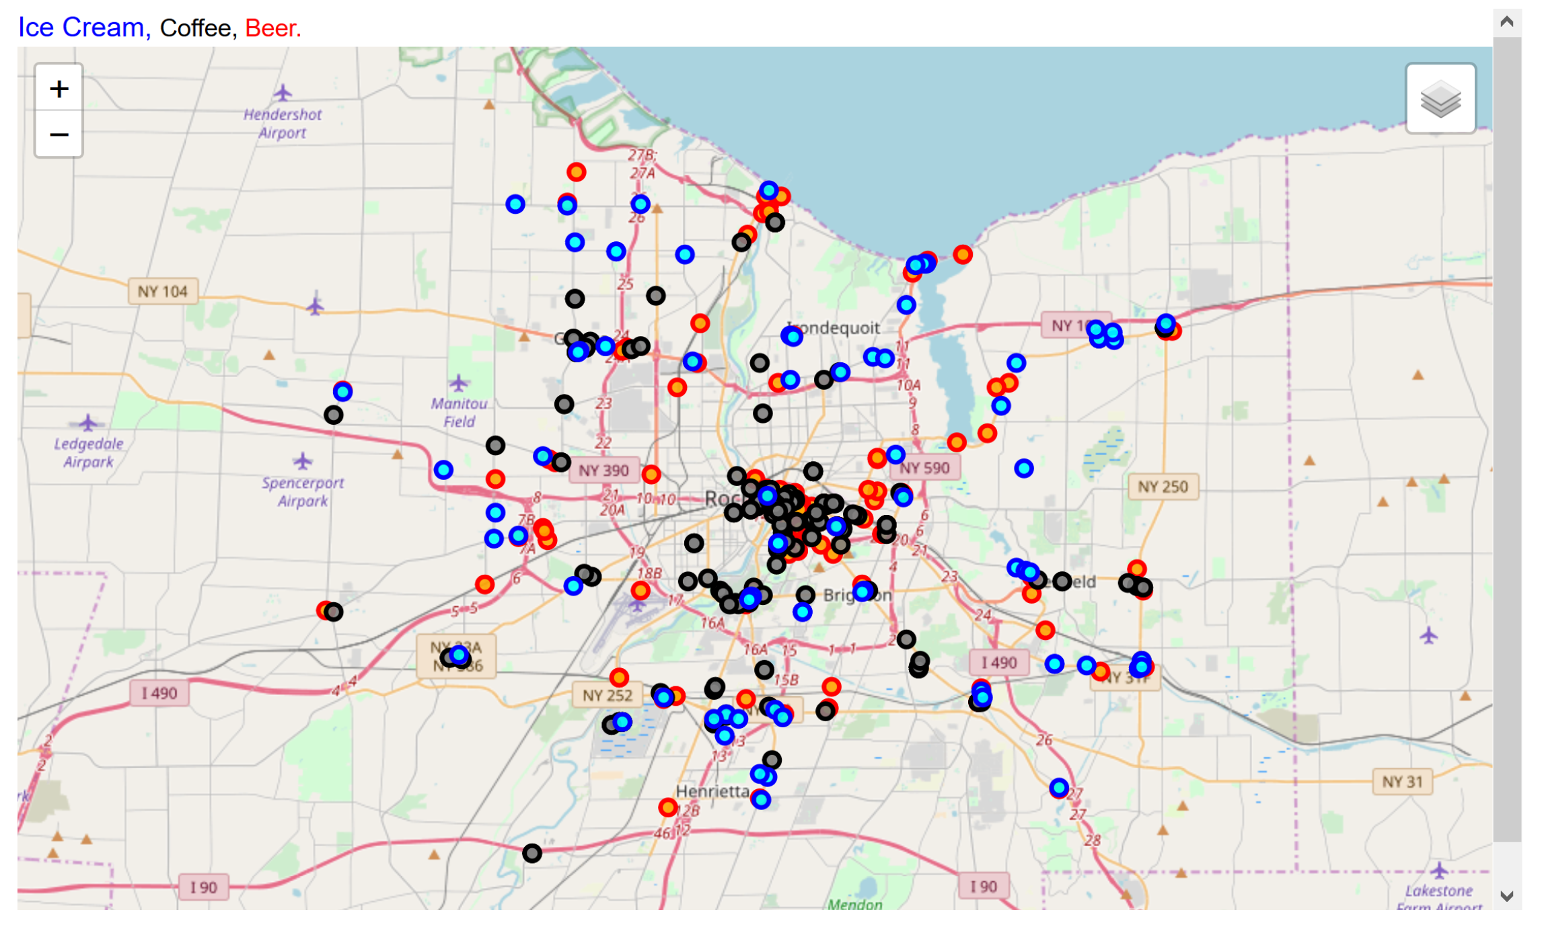
Locations for analysis (after Filtering)

Slide 6
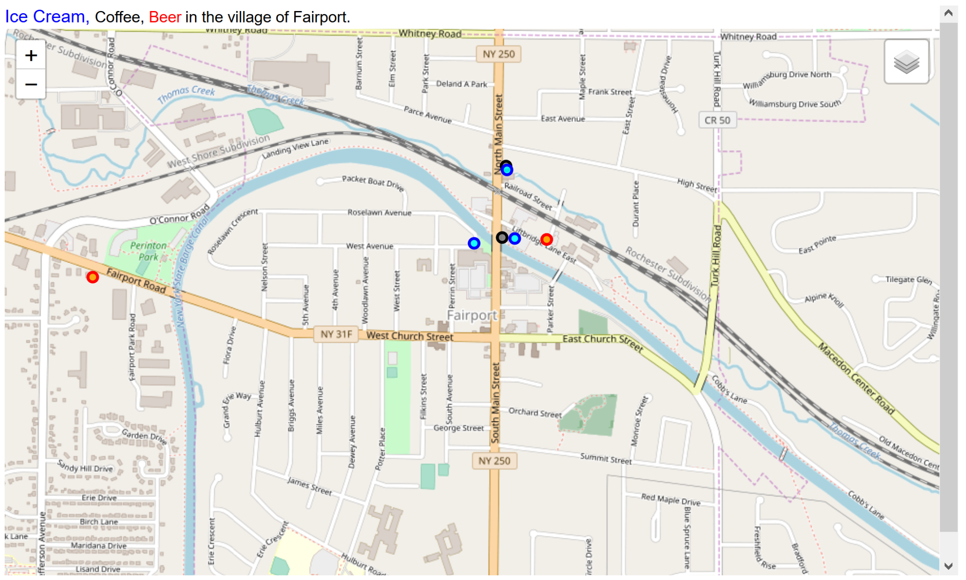
Quality check: How well did Foursquare do?
The results from Foursquare on Fairport were compared with what we know.
It turns out that Foursquare missed some locations of interest. The interpretation is that these missed localities have not just caught on yet, e.g., the missed brewery is fairly new, or, that they are
simply not that popular.
However, we can make the argument that if a site shows up on Foursquare it is likely to be popular. Hence, using Foursquare data should yield useful results; the downside being that we may miss some opportunities.

Slide 7
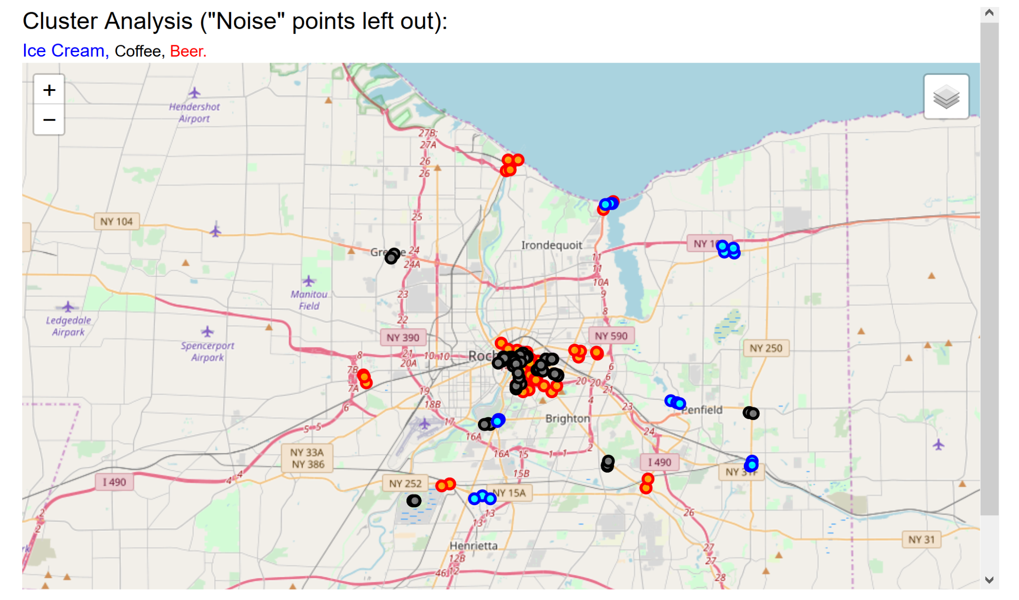
Cluster Analysis
For each group there are distinct clusters.
Not surprisingly the larges cluster is in the city of Rochester; curiously enough not ‘Ice Cream’.
Unfortunately there is not enough solid data to examine correlations between the locations of the different groups. The idea of surrogate did not pan out.

Slide 8
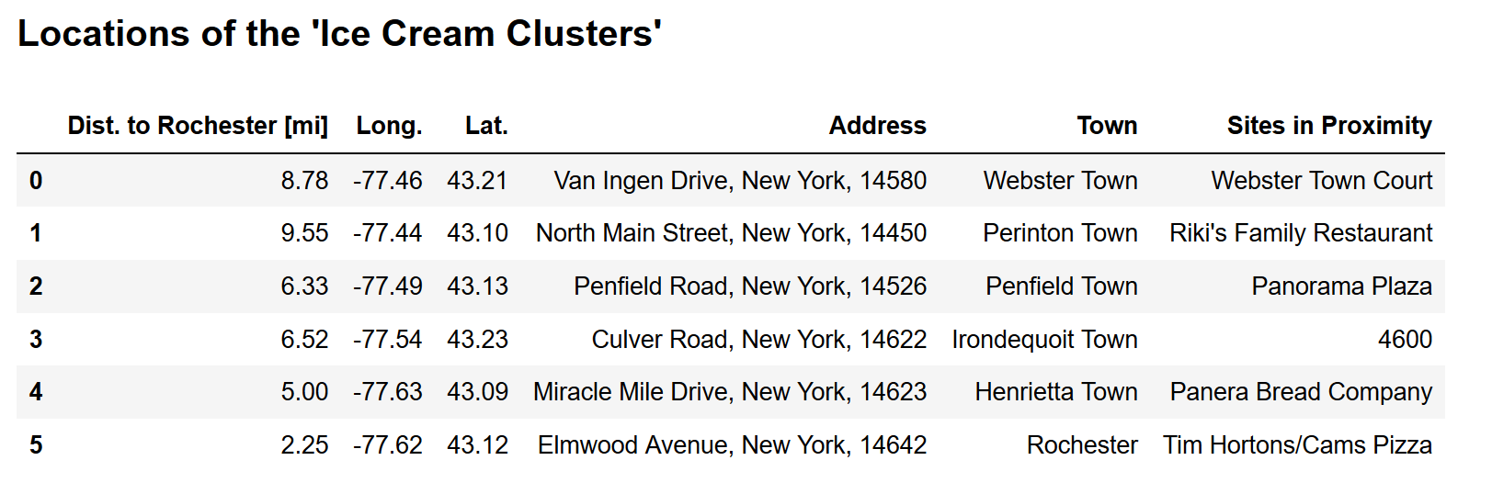
Common Thread
However we can pose the question what is common in the six Ice Cream clusters:
It was found that for each of the following, two had this in common:
Close to water
At or close to shopping plazas
Close to parks
Hence, looking at the map there are at least three promising candidate locations:
Piffsford Plaza, Town of Pittsford and Ontario Beach.
However, as a cautionary note, these locations may already have ice cream parlors; they may just not have been caught by Foursquare. Scouting out is needed.

Slide 9
Conclusion
Foursquare API was applied to mine data for the research of potential new ice cream locations in the greater Rochester area.
Data was filtered followed by a cluster analysis.
Unfortunately there was not enough supportive data to establish a surrogate for ice cream locations.
However, examining the 6 clusters of ice cream shops showed some common threads hat lead to potential candidate locations.
A study in wider scope is recommended.

